Slide 1

Welcome
Agile Methodology – Best Practices
by
Girish Godbole

Slide 2
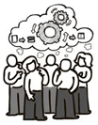
Agile software development emphasizes four core values. Individual and team interactions over processes and tools Working software over comprehensive documentation Customer collaboration over contract negotiation Responding to change over following a plan
Agile – The Manifesto

Slide 3
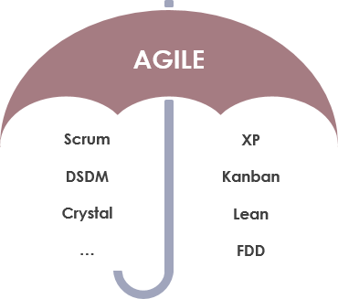
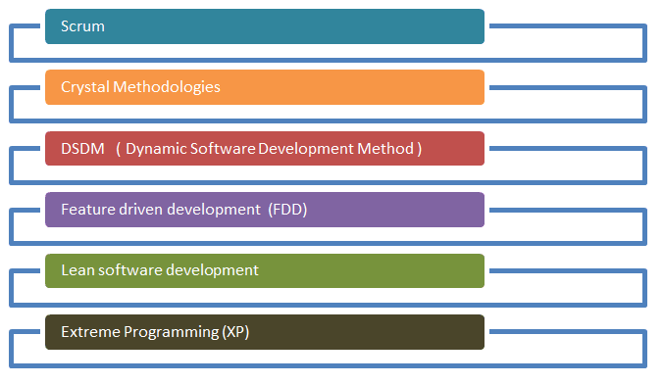
Agile Methods and Practices

Slide 4
Highest priority is to satisfy the customer through early and continuous delivery of valuable software. Welcome changing requirements, even late in development. Agile processes harness change for the customer's competitive advantage. Deliver working software frequently, from a couple of weeks to a couple of months, with a preference for a shorter timescale. Businesspeople and developers must work together daily throughout the project. Build projects around motivated individuals. Give them the environment and support they need and trust them to get the job done. The most efficient and effective method of conveying information to and within a development team is face-to-face conversation. Working software is the primary measure of progress. Agile processes promote sustainable development. The sponsors, developers, and users should be able to maintain a constant pace indefinitely. Continuous attention to technical excellence and good design enhances agility. Simplicity--the art of maximizing the amount of work not done--is essential. The best architectures, requirements, and designs emerge from self-organizing teams. At regular intervals, the team reflects on how to become more effective, then tunes and adjusts its behavior accordingly.
Agile – The Principles

Slide 5
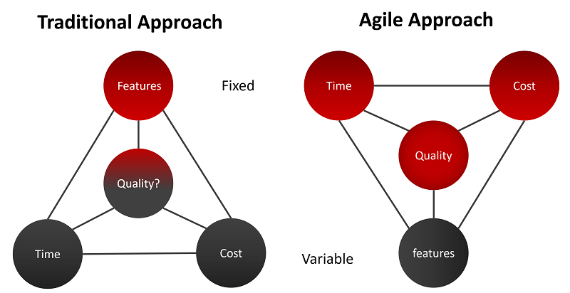
Agile – Approach

Slide 6
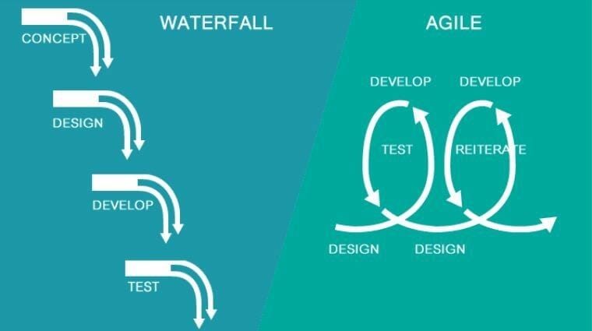
Traditional vs Agile Approach

Slide 7
Extreme Programming (XP) – Extreme Programming (XP) also emphasizes speed and continuous delivery. Like Scrum, XP enables closely-knit teams to deliver working software increments at frequent intervals, usually every 1-3 weeks. It relies on customers to communicate the most useful features of a software product and developers to work towards implementing that feedback. The five basic component of Extreme Programming are: 1. Communication 2. Simplicity 3. Feedback 4. Respect 5. Courage Extreme Programming allow changes in their set timelines. In Extreme Programming(XP), teamwork for 1-2 weeks only. Extreme Programming emphasizes strong engineering practices In Extreme Programming, team must follow a strict priority order or pre-determined priority order Extreme Programming(XP) can be directly applied to a team. Extreme Programming is also known for its Ready-to-apply features.
Agile Methods and Practices

Slide 8
Feature-Driven Development (FDD) – Feature-Driven Development, or FDD, provides a framework for product development that starts with an overall model and gets progressively more granular. Like other Agile methodologies, FDD aims to deliver working software quickly in a repeatable way. It uses the concept of “just enough design initially” (JEDI) to do so, leveraging two-week increments to run “plan by feature, design by feature, build by feature” iterations. Organizations that practice Agile like Feature-Driven Development for its feature-centric approach and its scalability. Five Step Process - Developing an overall model Building the feature list Planning by feature Designing by feature Building by feature FDD is amazing for big projects and is quite scalable and prone to get achieve success. FDD is very effective in helping with complex projects that are in a critical situation.
Agile Methods and Practices

Slide 9
Lean Software Development – Lean software development is more flexible than Scrum or XP, with fewer strict guidelines, rules, or methods. Lean is based on a set of principles developed to ensure value and efficiency in production in the mid 20th century and has evolved into the software setting. Lean relies on five principles of Lean management: Identify value Value stream mapping Create continuous workflow Create a pull system Continuous improvement Lean particularly emphasizes eliminating waste. In the context of software development, that includes cutting out wasted time and unproductive tasks, efficiently using team resources, giving teams and individuals decision-making authority, and prioritizing only the features of a system that deliver true value.
Agile Methods and Practices

Slide 10
Kanban – Kanban focuses on helping teams work together more effectively to enable continuous delivery of quality products. Kanban is unique, however, for offering a highly visual method for actively managing the creation of products. The Kanban Agile methodology relies on six fundamental practices: Visualize the workflow Limit work in progress Manage flow Make process policies explicit Implement feedback loops Improve collaboratively Kanban achieves these practices using a Kanban board. The Kanban board facilitates the visual approach to Agile using columns to represent work that is To Do, Doing, and Done. This Agile methodology improves collaboration and efficiency and helps define the best possible team workflow. To Do, In Progress, In Review, and Done (or Completed). The most important metrics are lead time and cycle time. Each of these metrics measures the average amount of time it takes for tasks to move through the board.
Agile Methods and Practices

Slide 11
Agile – Scrum Vs Kanban
 | Scrum | Kanban
Cadence | Regular fixed length sprints (i.e., 2 weeks) | Continuous flow
Release methodology | At the end of each sprint | Continuous delivery
Roles | Product owner, scrum master, development team | No required roles
Key metrics | Velocity | Lead time, cycle time, WIP
Change philosophy | Teams should not make changes during the sprint. | Change can happen at any time
Approach | A structured agile approach | Continuous improvement, flexible processes

Slide 12
Dynamic Systems Development Method (DSDM) The Dynamic Systems Development Method (DSDM) rounds out our list of well-known Agile methodologies. DSDM originated in the 1990s to provide a common industry framework for rapid software delivery. Today, it has matured into a comprehensive Agile methodology revolves around: Business needs and value Active user involvement Empowered teams Frequent delivery Integrated testing Stakeholder collaboration The DSDM framework is particularly useful for prioritizing requirements. It also mandates that rework is to be expected, so any development changes must be reversible. DSDM relies on sprints, similar to other Agile methodologies, and is often used in conjunction with approaches like Scrum and XP.
Agile Methods and Practices

Slide 13
Crystal - The Crystal Agile methodology focuses more on the interactions of the people involved in a project versus the tools and techniques of development. A lightweight model, Crystal emphasizes interaction, people, community, skills, communications, and talents. Crystal categorizes projects based on three criteria: Team size System criticality Project priorities The approach is similar to other Agile methodologies in its attention to early and often delivery of software, high involvement of users, and removal of red tape. Crystal’s assertion that every project is unique, however, has led to its reputation as one of the most flexible Agile methodologies.
Agile Methods and Practices

Slide 14
Scrum SCRUM is an agile development method which concentrates specifically on how to manage tasks within a team-based development environment. Basically, Scrum is derived from activity that occurs during a rugby match. Scrum believes in empowering the development team and advocates working in small teams (say- 7 to 9 members). Agile and Scrum consist of three roles, and their responsibilities are explained as follows:
Agile Methods and Practices

Slide 15
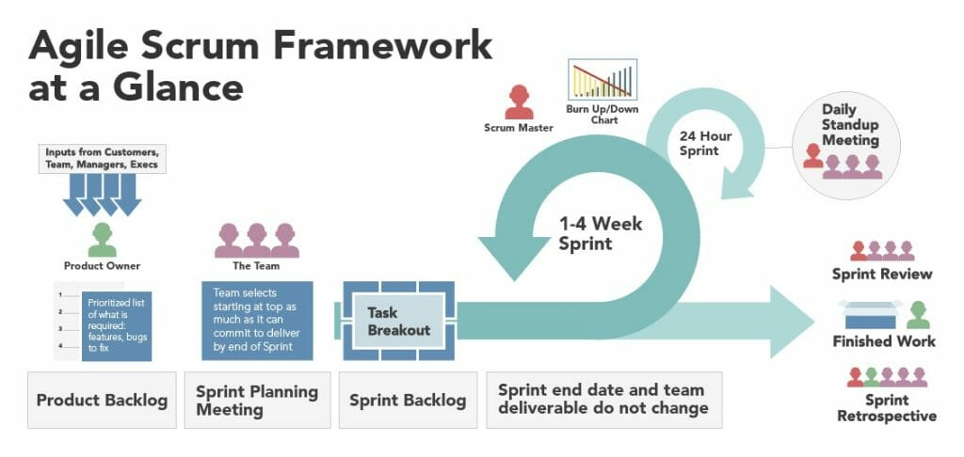
Agile – Scrum Framework

Slide 16

Agile Concepts – I know Agile concepts. All set for Applied Agile.

Slide 17

How do I apply my agile skills ?
How do I Manage ?
Which Tool will help me ?

Slide 18

Not to Worry. We have Many Tools available in Market. Trello, Wrike, Teamwork, ClickUp, Asana, Wrike etc.
Let’s go for most widely used tool called - JIRA

Slide 19



What is JIRA?
JIRA is powerful Work management Tool.
Jira is great at helping your team plan and track all the work.
It can help teams work faster, communicate more effectively due to its well-managed workflow, Mapping and issue tracking ability with minimal effort.

Slide 20
Jira – Default Roles
- Administrators (people who administer a given project).
- Developers (people who work on issues in each project).
- Users (people who log issues on a given project).

Slide 21

Jira - Activities
Configure Boards
Configure and Generate Reports
Get Active Sprint Data
Manage Backlog
Plan and Manage Sprints
Plan and Manage Stories (User Story, Bug)
Setup Project

Slide 22




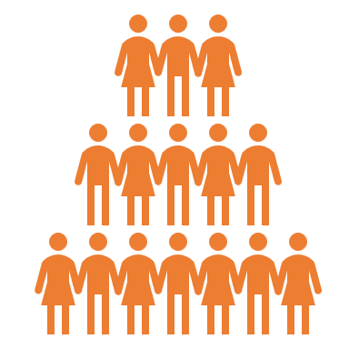



JIRA Hierarchy and Story definition
Portfolio Epic
Portfolio Epic and Initiative set by PMO and/or Lead BA/Product Owner
JIRA Portfolio
Initiative
Epics set by Asset BA/ Product Owner
User Story Types:
Development Story [BA]
Technical Debt Story [Dev Lead]
Automated Test story [Dev/QA]
QA Development story [QA]
SIT Test story [E2E QA Lead]
UAT Test story [BA]
No Spike or Chore Issue types
Epic
JIRA Projects
Story
Sub Task
Bug

Slide 23
Plan and Manage Sprints
How to create Sprint
How to Start Sprint
How to Manage Sprint
How to Manage Sprint Backlog

Slide 24
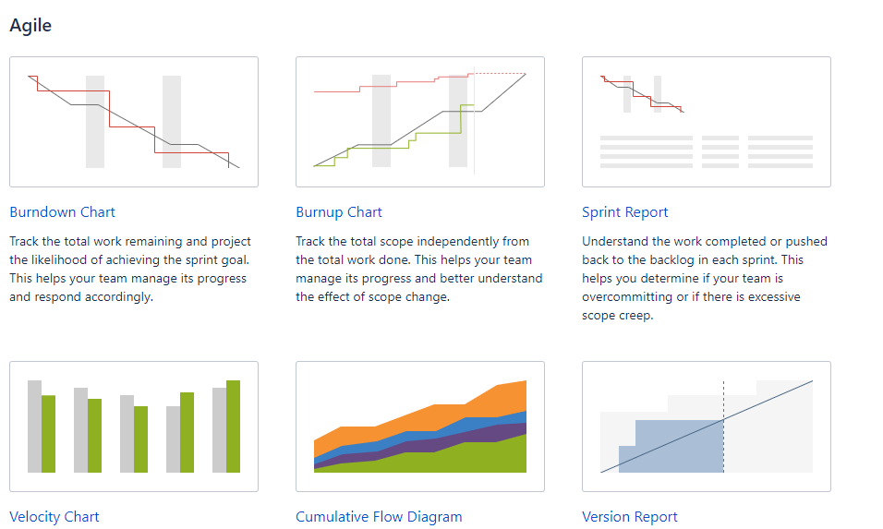
Jira – Configure and Generate Reports

Slide 25


